Slide 1
Industrial Psychology
Unit II

Slide 2
Industrial Psychology - In this unit…
Foundations of assessment - methods and procedures - types of test - role of assessment centers - computer and internet based assessments
Performance measurement - uses of performance information - theories and different types of performance rating - performance rating process - performance evaluation and performance feedback
Staffing decisions - conceptual issues in staffing - evaluation of staffing outcomes and practical and legal issues in staffing decisions
Foundations of training and learning - mentors and evaluation

Slide 3
Foundations of assessment
Robert Guion (1998) defined a test as “an objective and standardized procedure for measuring a psychological construct using a sample of behavior”
It encompasses paper-and-pencil tests, Internet testing, interviews, actual attempts to perform a piece of work (a work sample test), and even an application blank.
The definition is also broad enough to cover many different types of content, including cognitive ability, personality, values, communication skills, interpersonal skills, and technical knowledge.
Norming - Comparing a test score to other relevant test scores.
Norm group - Group whose test scores are used to compare and understand an individual’s test score.
The development of test norms is very technical; there is a need to interpret or give meaning to that score.
Guion (1998) suggested, the term “objective” in his definition of a test implies quantification—some kind of score on the test. It may be a simple pass–fail score (e.g., you may pass or fail a driver’s license examination) or a score on some graded continuum (such as an 88 percent or a B).

Slide 4
What Is a Test Battery?
A test battery is a collection of tests, usually of different attributes. These attributes may be within a single area, such as a cognitive battery including subtests of reasoning, memory, and comprehension; or the attributes may be from conceptually different areas, such as a battery that includes a measure of cognitive ability, a personality test, a physical ability test, and a test of vocational interests.
The term “battery” usually implies that all of the tests will be taken either in a single testing period or over a very short period of time.
But whether the information being considered is from several different assessment devices administered at one time or over a lengthy period of time, the critical issue is how to combine that information.
At various points in the text, we mention some specific tests by name. There are literally thousands of psychological tests available on a broad range of topics.

Slide 5
A complete listing of tests, can be found in two established sources. The first is the Mental Measurements Yearbook. This was first published in 1938 and has been updated 16 times. The 17th edition (Geisinger, Spies, Carlson, & Plake) was published in 2007.
The Buros Institute (named after the founder of the MMY, Oscar K. Buros) also publishes a companion volume without reviews called Tests in Print.
Scott and Reynolds (2010) published an excellent handbook on workplace assessment. It focuses on evidence-based practices for selecting and developing organizational talent, and it includes assessment for entry-level jobs as well as supervisory and leadership positions.
Some tests have rigid and demanding time limits such that most test takers will be unable to finish the test in the allotted time. These are called speed tests.
Power tests have no rigid time limits. While some test takers may still not finish, enough time is given for a majority of the test takers to complete all of the test items. The items on power tests tend to be answered correctly by a smaller percentage of test takers than those on speed tests.

Slide 6
Group test - A test that can be administered to large groups of individuals; often valuable in reducing the costs (both in time and money) of testing many applicants.
Group tests are efficient because they allow for the testing of many candidates simultaneously, resulting in rapid screening compared to individually administered tests. Group testing is also often valuable in reducing the costs (in both time and money) of testing many applicants.
Individual test - A test given only on an individual basis.
Individual tests are also often more appropriate when the employer wishes to assess a candidate’s style of problem solving rather than the simple products of the problem-solving process. Individual testing formats are also appropriate when the examiner needs to establish an interpersonal rapport with the test taker.

Slide 7
Paper-and-pencil test - One of the most common forms of industrial testing that requires no manipulation of any objects other than the instrument used to respond.
Paper-and-pencil tests are one of the most common forms of industrial testing. By extension, the modern version of the paper-and-pencil test might be the computer keyboard test where the keys and mouse are used only to choose the correct response or produce a narrative response to a question.
Performance test - A test that requires the individual to make a response by manipulating a particular physical object or piece of equipment.
Performance tests require the individual to make a response by manipulating a particular physical object or piece of equipment. The score that the individual receives on the test is directly related to the quality or quantity of that manipulation.

Slide 8
Murphy and Davidshofer (2005) distinguished among three terms in discussing tests and testing: bias, fairness, and culture.
Bias - Technical and statistical term that deals exclusively with a situation where a given test results in errors of prediction for a subgroup.
Fairness - Value judgment about actions or decisions based on test scores.
Culture - A system in which individuals share meanings and common ways of viewing events and objects.
International Assessment Practices - Several reviews of assessment in other countries help to illustrate the differences between assessment in the United States and assessment elsewhere Highlights from these reviews include the following:
European psychologists would like to have a more structured role for professional institutions in developing and monitoring good testing practices. In response to that expressed need, the International Test Commission developed the International Guidelines for Test Use (International Test Commission, 2000).
In industrial settings, the countries in which tests were most frequently administered by psychologists were Croatia, Bulgaria, Finland, Slovakia, Denmark, Japan, and Slovenia. The countries in which tests were most frequently administered by nonpsychologists included Canada, Sweden, Cyprus, Norway, Switzerland, the United Kingdom, and Germany.
The greatest amount of information about test quality could be found in the United States, the Netherlands, Japan, the United Kingdom, Canada, Spain, Finland, Belgium, and Slovakia; the least amount of information was available in China, Denmark, Ukraine, and South Africa.
In India and China, testing is largely unregulated; many countries are moving toward the certification and training of nonpsychologists who use tests (Bartram, 2005).

Slide 9
Assessment methods and procedure
There is a difference between what attribute is being assessed and how it is being assessed. For example, after applying for a job with a local company, an applicant might describe the process as including a personality test, a cognitive test, an interview, and a background check. The terms “personality” and “cognitive” describe the content of the assessment and the terms “interview” and “background check” describe the process of the assessment, where different attributes include cognitive ability, physical ability and personality.
Cognitive ability test - A test that allows individuals to demonstrate what they know, perceive, remember, understand, or can work with mentally; includes problem identification, problem-solving tasks, perceptual skills, the development or evaluation of ideas, and remembering what one has learned through general experience or specific training.

Slide 10
Cognitive Ability Tests may include:
Tests that produce a single score, ex. Wonderlic Personnel Test.
Tests of specific abilities, ex. Bennett Mechanical Comprehension Test.
Cognitive test batteries - Collection of tests that assess a variety of cognitive aptitudes or abilities; often called multiple-aptitude test batteries, ex. Scholastic Aptitude Test (SAT) or Graduate Record Examination (GRE). Although cognitive test batteries take longer to administer than a “single score” test like the Wonderlic or any test of an individual facet of cognitive ability, they do have the advantage of providing more detailed information about particular manifestations of cognitive ability that may be more important in one job than another.
Knowledge test A test that assesses the extent to which individuals understand course or training materials; also administered for licensing and certification purposes.

Slide 11
Tests of physical ability - While it is possible to measure each of these physical abilities in isolation, most physically demanding jobs actually require combinations of these abilities. As a result, many physical ability testing procedures tend to use simulated pieces of work to assess the combined abilities. For example, a test frequently used to assess the physical abilities of firefighter candidates is composed of several events such as stairway climb, hose pull, ladder pull, dummy drag, blind crawl, pike pole and fan hang.
Test to measure Psychomotor abilities - Physical functions of movement, associated with coordination, dexterity, and reaction time; also called motor or sensorimotor abilities.
Personality tests - commercially available instruments for measuring personality characteristics, many are based on the Big Five model.

Slide 12
Personality tests are of two types.
Screen-out test - A test used to eliminate candidates who are clearly unsuitable for employment; tests of psychopathology are examples of screen-out tests in the employment setting. Ex. Minnesota Multiphasic Personality Inventory II (MMPI-II), California Psychological Inventory (CPI), Personality Research Form (PRF) and Edwards Personal Preference Schedule.
Screen-in test - A test used to add information about the positive attributes of a candidate that might predict outstanding performance; tests of normal personality are examples of screen-in tests in the employment setting. Ex. Jackson Personality Inventory–Revised (JPI-R), 16 PF Select, NEO-PI, Hogan Personality Inventory and Saville Consulting Wave.

Slide 13
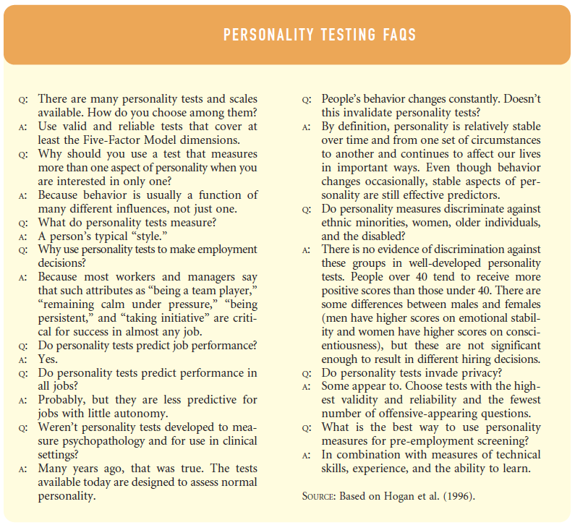

Slide 14
Faking is a controversial point about the personality tests - a behaviour in which subjects present themselves in a favourable manner, endorsing desirable traits and rejecting undesirable ones. Three questions should be kept in mind before considering faking in personality tests.
How difficult is it to fake personality tests? - not much difficult as personality is all about self-presentation; it is your public face, your “game face.” Forced choice tests could be a solution to some extent.
How many people do it? - Researches show that about 30% of the applicants fake themselves to be considered for the job position.
How much does it matter whether people do or do not fake? - Doesn’t influence much as the personality differ in different Frame of Reference (FOR) - at work, school or at home.
Integrity tests are administered to assess whether the honesty of the potential candidate is acceptable in respect to theft and counterproductive work behaviour. They are economic when compared to the high cost of dishonest employees and have a good predictive power.

Slide 15
There are two different types of integrity tests:
Overt integrity test - A test asks questions directly about past honesty behavior (stealing, etc.) as well as attitudes toward various behaviors such as employee theft. Examples of questions are - there is nothing wrong with telling a lie if no one suffers any harm (True or False?), how often have you arrived at work under the influence of alcohol? and do your friends ever steal from their employers?
Personality-based integrity test - A test that infers honesty and integrity from questions dealing with broad constructs such as conscientiousness, reliability, and social responsibility and awareness. Questions for example are, Do you like taking risks?. Would your friends describe you as impulsive?, Would you consider challenging an authority figure?, etc.
Emotional Intelligence
Emotional intelligence (EI) - A proposed kind of intelligence focused on people’s awareness of their own and others’ emotions.
Emotional intelligence quotient (EQ) - Parallels the notion of intelligence quotient (IQ); a score on a test of emotional intelligence.

Slide 16
Individual and group assessment
Individual assessment - Situation in which only one candidate (or a very few) is assessed on many different attributes.
The “typical” individual assessment is likely to include ability tests, personality tests, a personal history statement, and interviews.
Although frequently used for selection, individual assessment can also be used to identify training needs or to provide career counseling or performance feedback to key organizational members.
Because it is time-intensive and requires skilled assessors, it is expensive and unlikely to be used for any other than key positions in the company.

Slide 17
Interviews - content
In one form or another, an interview plays a role in virtually every selection or promotion decision.
Interview content is often dictated by the amount of structure in the interview.
Structured interview - Assessment procedure that consists of very specific questions asked of each candidate; includes tightly crafted scoring schemes with detailed outlines for the interviewer with respect to assigning ratings or scores based on interview performance.
Situational interview - An assessment procedure in which the interviewee is asked to describe in specific and behavioral detail how he or she would respond to a hypothetical situation.
The situational interview can be contrasted with another form of structured interview known as the behavior description interview.
The basic difference between them is a time orientation. The situational interview asks the applicant what he or she would do, whereas the behavior description interview asks the applicant what he or she did do in the past.

Slide 18
Unstructured interview - An interview format that includes questions that may vary by candidate and that allows the candidate to answer in any form he or she prefers.
Interview - process
Independent of the actual content of the interview, there are many relevant process issues which should answer questions like
How should interviews be conducted?
How should interviewers be trained?
What are some potential sources of bias in interviews?
Interviewees may have a completely different set of anxieties and priorities when it comes to the interview These anxieties revolve around communication, appearance, social skills, interview performance, and behavioral control.

Slide 19
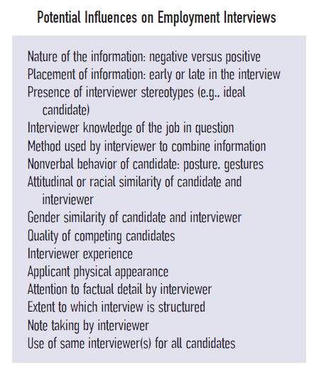

Slide 20
Assessment centers
Even though the word “center” evokes an image of a physical place, assessment centers are collections of procedures for evaluation, no matter where these procedures are carried out.
Assessment centers are very much like the individual assessment procedure except they are administered to groups of individuals rather than single individuals, and the assessments are typically done by multiple assessors rather than a single assessor.
In earlier years, there were as many variations of assessment centers as there were users. For this reason, a task force published Guidelines and Ethical Considerations for Assessment Center Operations (Task Force on Assessment Center Guidelines, 1989). These guidelines have done much to standardize the assessment center process and protect the rights of those being assessed.

Slide 21
Most assessment centers share the following characteristics (Finkle, 1976):
1. Assessment is done in groups. A typical group size is 12, although smaller subgroups may be formed for specific exercises. The group format provides opportunity for peer evaluation.
2. Assessment is done by groups. Unlike the usual evaluators in individual assessment, assessment center evaluators are usually managers chosen from the organization but unfamiliar with the candidates.
3. Multiple methods of assessment are employed. As with individual assessment, these might include paper-and-pencil tests, group exercises, interviews, and clinical testing. A typical group exercise might be a leaderless group discussion that is observed and rated by the assessors. An individual exercise might be an in-basket exercise in which a candidate is presented with the contents of a typical in-basket and asked to deal with each element in the basket by making a phone call, sending an email, writing a memo or starting a file for information.
4. Assessment centers invariably have a “feel” of relevance to them, both for assessors and for those being assessed. They are seen as much more “real” than interviews, paper-and-pencil tests or even isolated work simulations.

Slide 22
Role of assessment centers
As in the individual assessment procedure, the results of the assessment center may include a report, recommendation, and feedback to the participants. An excerpt from a typical report appears in Table 3.8. On the basis of assessment center results, the organization may make one or more of the following decisions (Finkle, 1976):
1. An assessee may or may not qualify for a given job or job level.
2. Assessees may be ranked on a series of attributes and placed into different categories representing anticipated speed of promotion (e.g., fast track versus normal progression groups).
3. Predictions of long-range potential may be made for one or more of the assessees.
4. Development and learning experiences for aiding the assessee in personal or professional growth might be recommended.
There is general agreement that assessment centers can be valuable procedures for selection, promotion, and training needs analysis

Slide 23
Work Samples and Situational Tests
Work sample test - Assessment procedure that measures job skills by taking samples of behavior under realistic job-like conditions.
In today’s work sample tests, the performance may or may not be assessed at an actual workstation, but the task assigned and the equipment used to complete the task are designed to be realistic simulations of the actual job.
Situational judgment test - Commonly a paper-and pencil test that presents the candidate with a written scenario and asks the candidate to choose the best response from a series of alternatives.

Slide 24
Performance measurement
In work settings, performance measurement often goes beyond the annual review and can be used for many purposes. Some of the most common uses of performance information are the following:
Criterion data. In a criterion-related validation study of a selection device, the work psychologist can correlate an individual’s performance data with test data to determine if the test predicts successful performance.
Employee development. A worker is given information about strengths and weaknesses, and works with a supervisor to develop a plan to improve weaknesses and build upon strengths. Based on the profile of performance strengths and weaknesses, employers may design a series of training modules or experiences for an employee.
Motivation/satisfaction. By setting appropriate performance standards, evaluating employees’ success in meeting those standards, and giving employees feedback regarding the extent to which they are meeting or exceeding those standards, an organization can increase the motivation and satisfaction of those employees.

Slide 25
Rewards. Employers compare workers to one another to determine how to distribute rewards such as salary increases and bonuses. Rynes, Gerhart, and Parks (2005) provide a comprehensive review demonstrating the value of tying pay to performance measurement.
Transfer. Employers can use a profile of performance capabilities to determine which employees are best suited for a transfer from one job family or job title to another.
Promotion. To the extent that documented performance capabilities are part of a higher-level job, employers can use performance information as part of the assessment procedure that determines promotions.
Layoff. If an organization finds it necessary to downsize, an important factor that might be used to guide the selection of those to be laid off could be performance; employees with the lowest performance would be the most likely candidates for layoff.

Slide 26
Objective performance measure - Usually a quantitative count of the results of work such as sales volume, complaint letters, and output.
Judgmental performance measure - Evaluation made of the effectiveness of an individual’s work behavior, most often by supervisors in the context of a yearly performance evaluation.
Hands-on performance measurement - Type of measurement that requires an employee to engage in work-related tasks; usually includes carefully constructed simulations of central or critical pieces of work that involve single workers.
Walk-through testing - Type of measurement that requires an employee to describe to an interviewer in detail how to complete a task or job-related behavior; employee may literally walk through the facility (e.g., a nuclear power plant), answering questions as he or she actually sees the displays or controls in question.
Electronic performance monitoring - Monitoring work processes with electronic devices; can be very cost effective and has the potential for providing detailed and accurate work logs.

Slide 27
Performance rating - theories
Since performance rating is one of the most common techniques for performance measurement, it has received a great deal of attention. This attention has led to increasingly sophisticated
models of the performance rating process. One of the early theories was presented by Landy and Farr (1980), who addressed the various factors in the process of rating.
This dizzying array of possible influences points out the complexity of the performance rating process.
In the years since that model was proposed, other researchers have presented additional models. These models have often emphasized cognitive factors (e.g., memory, reasoning, and information processing) rather than situational ones (Feldman, 1981; Woehr & Feldman, 1993).

Slide 28
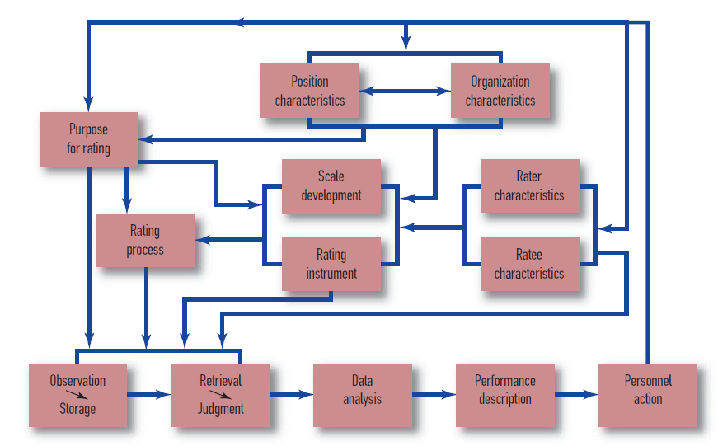
A Process Model of Performance Rating - Source: Landy F.J., & Farr. J. L. (1980)

Slide 29
Types of performance rating
Overall performance rating - Recent researches have found that overall ratings of performance were influenced by three factors: task performance, organizational citizenship behavior (OCB), and counterproductive work behavior (CWB). The relative importance of these factors did not vary by job, even though a wide variety of jobs were included: accountant, administrative assistant, cashier, machine operator, and nurse.
Trait rating - Performance ratings were introduced by Paterson in 1923 and, at that time, it was common to have supervisors evaluate subordinates on traits such as persistence, concentration, or alertness. Traits are habits or tendencies that can be used as predictors of performance but not as measures of performance.The modern view of performance evaluation is that the rater should be describing actions or behaviors (Campbell, 1990a) rather than broad and amorphous “traits” that may or may not be of value in a job.

Slide 30
Task-based rating - Task-based performance rating systems are usually a direct extension of job analysis The rater is asked to indicate the effectiveness of an employee on individual critical tasks or on groups of similar tasks, often called duties, to distinguish task groups from individual tasks.These types of ratings tend to be the most easily defended in court, and most easily accepted by incumbents, because of the clear and direct relationship between the duties rated and the job in question.
Critical Incidents Methods - Critical incidents (Flanagan, 1954) are examples of behavior that appear to be “critical” in determining whether performance would be good, average, or poor in specific performance areas (Landy, 1989).
OCB and Adaptive Performance Ratings - Although the rating of OCB is still relatively new by psychological standards, it has accumulated an impressive research base. The research on the identification of OCB dimensions suggests that these are valuable additions to task-based performance rating.

Slide 31
Performance rating - process
Sources
A relatively new and increasingly popular development in performance measurement is called the 360-degree assessment, which includes many and sometimes all of these sources.
Supervisors - First- and second-level managers and supervisors are by far the most common source of performance information. Supervisors can closely observe the behavior of the incumbent, and they are in a good position to evaluate the extent to which that behavior contributes to department and organizational success.
Peers - Peers are more likely than supervisors to interact with a worker on a daily basis; thus, peers may be more likely to know more about typical performance. In contrast, supervisors are more likely to be familiar with maximum performance. Thus, in theory, peers should be a good source for performance information.

Slide 32
Self-Ratings - Self-ratings have often been part of the traditional performance appraisal system. An individual is told to complete a rating form on himself or herself and bring it to a meeting with the supervisor, who has filled out the identical form on the subordinate. The supervisor and subordinate then discuss agreements and disagreements in the ratings they have assigned. As a result of the discussion, the “final” rating form that the supervisor places in the employee’s personnel file is a consensus form, one that evolves from the discussion.
Subordinate Ratings - Increasing numbers of organizations are looking at the value of a subordinate’s evaluation of a boss.
Customer and Supplier Ratings - Many job titles require interaction with individuals outside the organization. The most obvious of these is the customer, but employees may also have important interactions with suppliers and vendors who provide materials and services to the organization. The perspective of these outside parties is likely to be unique and provides the opportunity to fill out the employee’s performance profile.

Slide 33
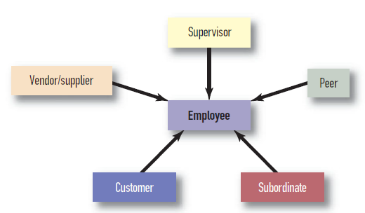
360-Degree Systems
The collection of information sources we have reviewed represents a wide variety of perspectives. It seems clear that by using these sources, we can examine the behavior of an employee from many possible angles (Oh & Berry, 2009). Thus, the use of the varied sources has become known as the 360-degree evaluation. Because of the sensitivity of information from some of these sources and because of the potential conflicts that arise when administrative issues are involved, 360-degree systems are often used for feedback and employee development.

Slide 34
Rating distortions
Even though the intent of a rating system is to collect accurate estimations of an individual’s performance, and we build in structural characteristics to assist in the gathering of those accurate estimations, raters don’t always provide accurate estimates.
These have traditionally been labeled rating errors, but they may not really be “errors” as much as intentional or systematic distortions.
Rating errors - Inaccuracies in ratings that may be actual errors or intentional or systematic distortions.
Central tendency error - Error in which raters choose a middle point on the scale to describe performance, even though a more extreme point might better describe the employee.

Slide 35
Leniency error - Error that occurs with raters who are unusually easy in their ratings. The easy rater gives ratings higher than employees deserve.
Severity error - Error that occurs with raters who are unusually harsh in their ratings. The harsh rater gives ratings lower than employees deserve.
Halo error - Error that occurs when a rater assigns the same rating to an employee on a series of dimensions, creating a halo or aura that surrounds all of the ratings, causing them to be similar. This might be the result of simple laziness on the part of the rater or because the rater believes that one particular dimension is key and all the other dimensions or performance areas flow from that one important area.

Slide 36
Rater Training
It has generally been assumed that rater distortions are unintentional, that raters are unaware of influences that distort their ratings. There is also another version of the assumption that the raters may know exactly what they are doing and why they are doing it. Whatever be the reason, some distortions may be corrected through training. We will consider three types of training:
Administrative - Most evaluation systems are straightforward and easy to understand, such as the traditional graphic rating systems. Experienced managers have been doing performance ratings for their entire managerial careers. They themselves have also been evaluated in management and non-management positions. If one or more of the structural characteristics (e.g., dimension definition, anchors, method for assigning or interpreting a rating) is deficient, administrative training becomes more important. The training would be directed toward developing a consensus among raters about the meaning of dimension headings or anchor meanings.

Slide 37
Traditional psychometric training - Training that makes raters aware of common rating errors (central tendency, leniency/severity, and halo) in the hope that this will reduce the likelihood of errors.
Frame-of-Reference training - Training based on the assumption that a rater needs a context or “frame” for providing a rating; includes
(1) providing information on the multidimensional nature of performance
(2) ensuring that raters understand the meaning of anchors on the scale
(3) engaging in practice rating exercises and
(4) providing feedback on practice exercises.
I-O psychologists continue to be concerned about the reliability and validity of performance ratings. The relatively low inter-rater reliability of performance ratings likely results from the different behavior described by each information source. The challenge is to combine those sources to get the full performance picture. The more information gathered, the more comprehensive and accurate the complete performance estimate will be.

Slide 38
Performance evaluation
An extension of the use of job analysis for criterion development is the development of performance evaluation systems. Once the job analyst identifies critical performance components of a job, it is possible to develop a system for evaluating the extent to which an individual worker has fallen short of, met, or exceeded the standards set by the organization for performance on those components.
Since the 1980s, many organizations have replaced the terms “performance appraisal” and “performance evaluation” with the term “performance management.” Performance management systems emphasize the link between individual behavior and organizational strategies and goals by defining performance in the context of those goals.

Slide 39
Motivation for rating
Cleveland and Murphy (1992) delineated the goals of each stakeholder as follows.
Rater Goals
Task performance: using appraisal to maintain or enhance the ratee’s performance goals or levels
Interpersonal: using appraisal to maintain or improve interpersonal relations with the ratee
Strategic: using appraisal to enhance the standing of the supervisor or work group in the organization
Internalized: using appraisal to confirm the rater’s view of himself or herself as a person of high standards
Ratee Goals
Information gathering: to determine the ratee’s relative standing in the work group; to determine future performance directions; to determine organizational performance standards or expectations
Information dissemination: to convey information to the rater regarding constraints on performance; to convey to the rater a willingness to improve performance

Slide 40
Organizational Goals
Between-person uses: salary administration, promotion, retention/termination, layoffs, identification of poor performers
Within-person uses: identification of training needs, performance feedback, transfers/ assignments, identification of individual strengths and weaknesses
Systems-maintenance uses: manpower planning, organizational development, evaluation of the personnel system, identification of organizational training needs
Goal Conflict
The problem with having multiple stakeholders with differing goals is that they often conflict when a single system is used for performance evaluation. Consider some typical conflicts:
A rater wants to make his or her group look good, a ratee wants to learn what the organizational performance standards are, and an organization wants to make salary decisions.
A rater wants to motivate a ratee to perform at a higher level, a ratee wants to explain why his or her performance was constrained by work conditions, and an organization wants to make layoff decisions.

Slide 41
Performance feedback
Individual workers seek feedback because it reduces uncertainty and provides external information about levels of performance to balance internal (self) perceptions (Murphy & Cleveland, 1995). Most workers prefer to receive positive feedback, and most supervisors prefer to give positive feedback. But there is always room for improvement, so most workers get mixed feedback, some positive and some directed toward improving skills or eliminating weaknesses. This becomes particularly problematic when the same information is used for multiple purposes.
The employee is more likely to accept negative feedback if he or she believes the following:
The supervisor has a sufficient “sample” of the subordinate’s actual behavior.
The supervisor and subordinate agree on the subordinate’s job duties.
The supervisor and subordinate agree on the definition of good and poor performance.
The supervisor focuses on ways to improve performance rather than simply documenting poor performance.

Slide 42
Destructive criticism - Negative feedback that is cruel, sarcastic, and offensive; usually general rather than specific and often directed toward personal characteristics of the employee rather than job-relevant behaviors.
360 degree feedback - an organization has a wide array of possible information sources for performance evaluation. It is also true, as a general principle, that the greater the number of independent sources, the more complete the performance picture.
Performance evaluation and culture
Organizations need to be sensitive to cultural issues when introducing performance evaluation systems into multinational environments. The effect of simply applying one-size-fits-all results across multinational samples (e.g., Colombian, Chinese, and North American managers) can be misleading at best and counterproductive at worst. Davis suggested that Hofstede’s five dimensions of culture might affect performance evaluations

Slide 43
Davis suggested that Hofstede’s five dimensions of culture might affect performance evaluations as follows:
● Individualist cultures will be more amenable to traditional performance evaluation; collectivist cultures will be more amenable to the evaluations of groups or teams.
● Cultures characterized as high in power distance will be more resistant to 360-degree systems than those low in power distance.
● Cultures with low tolerance for uncertainty will tend to be characterized by blunt and direct performance feedback.
● Masculine cultures will emphasize achievement and accomplishments, whereas feminine cultures will emphasize relationships.
● Short-term-orientation cultures will emphasize relationships rather than performance; long-term-orientation cultures will emphasize behavioral change based on performance feedback.

Slide 44
Performance evaluation and the law
Forced-distribution rating system - Rating system that requires evaluators to place employees into performance categories based on a predetermined percentage of employees in different categories (low, moderate, high).
Policy capturing - Technique that allows researchers to code various characteristics and determine which weighed most heavily in raters’ decision making.
The characteristics most commonly cited in the decisions were
whether or not a job analysis was used to develop the system,
whether the raters were given written instructions,
whether the organization provided a mechanism for employees to appeal their ratings, and
whether multiple raters agreed on the ratings.

Slide 45
Performance evaluation and the protected groups
As the cultural and ethnic diversity of the 21st-century workplace continues to expand, it will be worth an additional look at the relationship between performance evaluation and protected group membership. An ethnic minority is no longer simply African American or Hispanic. He or she may be from Trinidad, or Turkey, or Iraq, or Poland. We need to expand our knowledge regarding potential bias in ratings to these new groups of ethnic minorities. It is difficult for any HR system, including a performance evaluation system, to prevent an individual intending to discriminate unfairly from doing so. But there is nothing inherent in the performance evaluation system per se that leads to systematic discrimination against commonly studied protected groups.

Slide 46
Staffing decision
For the organization, tools like value of a diverse workforce, individual attributes and their value in job success, and assessment devices such as tests are used to make decisions about whom to hire, whom to promote, or even whom to lay off. These decisions are called staffing decisions because they determine and define the staff or workforce of the organization.
Staffing decisions - Decisions associated with recruiting, selecting, promoting, and separating employees.
It is important to note that from practical, scientific, and legal perspectives, the decision to separate an individual from an organization (layoff or termination, sometimes called “deselection”) involves many if not all of the same issues that are in play in hiring or promoting an individual.
According to Guion’s model (1998), organizations use a job or need analysis to identify the characteristics of individuals they would like to hire (or, in the layoff situation, those they would like to retain).

Slide 47
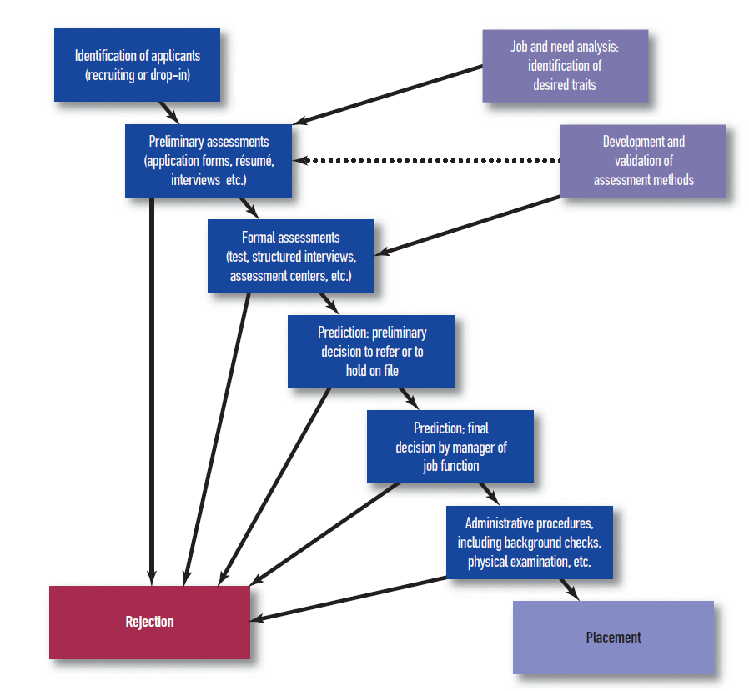

Slide 48
Staffing practices (and HR practices more generally as well) do have a positive association with firm performance. Wright, Gardner, Moynihan, and Allen (2005) present evidence that could support any of three interpretations of positive association between HR practices and high firm performance:
HR practices result in high firm performance.
High firm performance results in improved HR practice.
Both HR practice and firm performance are the result of leadership or CEO performance.
High-performance work practices - Practices that include the use of formal job analyses, selection from within for key positions, merit-based promotions, and the use of formal assessment devices for selection.
In making staffing decisions, line managers, co-workers and the applicants or the candidates play a vital role.
In many organizations, line managers are actively involved in the selection decision, in terms of both gathering information from applicants, usually in the form of one or more interviews, and sharing in the ultimate decision regarding whom to hire, promote, or lay off.

Slide 49
Co-worker has a stake in the staffing decision. If the decision is a hiring or promotion decision, the co-worker will be either a peer or a subordinate. In a layoff, the decision may have both practical and emotional consequences including feeling guilty and having an impact on the OCB of the new recruit.
When applicants are rejected by the staffing system, they are more likely to think poorly of the organization and view the staffing process as biased or impersonal. Even if they are selected, the manner by which the staffing decision is carried out will have an influence on how they perceive the culture and climate of the organization.
There are additional potential stakeholders in the staffing process. This includes the society, the family members of both new recruits and laid off and the minority groups.
Culture and government regulations are some of the factors influencing staffing decision.
Multinational staffing - Procedures that involve staffing for organizations in more than one country.

Slide 50
Staffing outcomes
Staffing outcomes might be evaluated in a number of different ways. The three major aspects of evaluation are validity, utility, and fairness.
Staffing decisions involve inferences about the match between a person and a job; the decision maker would like to infer or predict something about the probable success of various candidates and to choose those candidates with the highest probability of success. Thus, staffing decisions are, or ought to be, valid decisions.
Validity - The accurateness of inferences made based on test or performance data; also addresses whether a measure accurately and completely represents what was intended to be measured.
Criterion-related validity - Validity approach that is demonstrated by correlating a test score with a performance measure; improves researcher’s confidence in the inference that people with higher test scores have higher performance.

Slide 51
Selection ratio (SR) - Index ranging from 0 to 1 that reflects the ratio of positions to applicants; calculated by dividing the number of positions available by the number of applicants.
Low selection ratios are actually better than high selection ratios because the more people we assess, the greater the likelihood that we will find individuals who score high on the test.
In making a staffing decision, we might commit two types of errors. We might predict that a person will be a successful performer, but the individual turns out to be unsuccessful. This is an error called a false positive: We falsely predicted that a positive outcome would occur and it did not—the person failed.
The second type of error occurs when someone we predicted would be a poor performer actually turns out to be successful. This error is called a false negative: We falsely predicted a negative outcome would occur and it did not—the person succeeded.

Slide 52
True negative - Decision in which an applicant was rejected and would have performed poorly if he or she were hired; decision is true because of the correct prediction that the applicant would not be a good performer and negative because the applicant was not hired.
True positive - Decision in which an applicant was accepted and performed successfully; decision is true because of the correct prediction that the applicant would be a good performer and positive because the applicant was hired.
Using a criterion-related design, it is relatively easy to grasp the issue of false-positive and false negative prediction errors because we have a criterion score distribution on which we can designate the differentiating line between success and failure.
Cut score - Specified point in a distribution of scores below which candidates are rejected.
There are two different ways of establishing cut scores: the criterion-referenced method and the norm-referenced method.

Slide 53
Criterion-referenced cut scores (sometimes called domain-referenced cut scores) are established by actually considering the desired level of performance for a new hire and finding the test score that corresponds to that desired level of performance.
Norm-referenced cut scores are not tied to any expected level of performance on the job. The term “norm” is a shortened version of the word “normal,” or average. Thus, norm referenced cut scores are based on the average of the test takers’ scores rather than any notion of job performance.
In educational settings, passing scores are typically pegged at 60. Any score below 60 is assigned a letter grade of F (for “failing”) and a student gets no accumulated credit for work in that course.
Utility analysis - Technique that assesses the economic return on investment of human resource interventions such as staffing and training. A utility analysis addresses the cost/benefit ratio of one staffing strategy versus another.

Slide 54
Fairness - There are many different ways of defining a “fair” staffing strategy. Feelings of unfairness often lead to some negative action on the part of an employee or applicant. These actions include the initiation of lawsuits, filing of formal grievances with company representatives, and counterproductive behavior.
Feelings of unfairness, when acted upon, almost always cost the organization time and money and detract from the overall value of the staffing strategy.

Slide 55
Practical issues in staffing decisions
Modern jobs are complex. They consist of personal, interpersonal, and technical demands.
To succeed in 21st-century jobs, individuals must have attributes like conscientiousness, general mental ability, communication skills, and specialized knowledge.
Comprehensive selection system - Model that gathers enough high-quality information about candidates to predict the likelihood of their success on the varied demands of the job. Broadly, we should be able to predict both technical performance and OCB performance. Within each of those domains, we should be trying to predict more specific important behaviors as well. These behaviors are usually identified through a job analysis.

Slide 56
Compensatory selection system - Generally speaking, most knowledge, skills,abilities, and other characteristics (KSAOs) interact to yield successful performance. This means that we can average them together, much as we would average individual course grades to get an overall GPA.
In most instances, humans are able to compensate for a relative weakness in one attribute through a strength in another one, assuming both attributes are required by the job.
Combining Information
There are two basic ways to combine information in making a staffing decision: clinical and statistical.
Clinical decision making - Method uses judgment to combine information and to make a decision about the relative value of different candidates or applicants.
Statistical decision making - Method combines information according to a mathematical formula.

Slide 57
Compensatory system - Model in which a good score on one test can compensate for a lower score on another test.
Hurdle system - Non-compensatory strategy in which an individual has no opportunity to compensate at a later assessment stage for a low score in an earlier stage of the assessment process.
Multiple hurdle system - Strategy constructed from multiple hurdles so that candidates who do not exceed each of the minimum dimension scores are excluded from further consideration.
Hurdle systems are often employed when there are large numbers of candidates and few openings.
Multiple regression analysis - Method of analysis that results in an equation for combining test scores into a composite based on the correlations among the test scores and the correlations of each test score with the performance score.

Slide 58
Cross-validation - Process used with multiple regression techniques in which a regression equation developed on a first sample is tested on a second sample to determine if it still fits well; usually carried out with an incumbent sample, and the cross validated results are used to weight the predictor scores of an applicant sample.
Score banding - Approach in which individuals with similar test scores are grouped together in a category or score band, and selection within the band is then made based on other considerations.
Standard error of measurement (SEM) - Statistic that provides a measure of the amount of error in a test score distribution; function of the reliability of the test and the variability in test scores.
Subgroup norming - Approach that develops separate lists for individuals within different demographic groups, then ranks the candidates within their respective demographic group.

Slide 59
Deselection - There are two typical situations in which an individual is selected to leave rather than join an organization. The first is termination for cause, and the second is a layoff or downsizing situation.
Termination for cause - Job loss that occurs when an individual is fired from an organization for a particular reason; the individual has usually been warned one or more times about a problem and either cannot or will not correct it.
Layoff - Job loss due to employer downsizing or reductions in force; often comes without warning or with a generic warning that the workforce will be reduced.
Number of Decisions to Be Made -
Large staffing projects
Small staffing projects

Slide 60
21st-Century Staffing
Cascio and Aguinis are making the point: One can better understand the nature of job performance by considering it in the broader context rather than taking a narrow view of a worker at a desk or machine. They use the term “in situ performance” to describe this new view. They suggest that the 21st-century staffing model should include the following departures from earlier staffing approaches:
1. Assessment of predictors over a longer period of time—weeks or months—rather than a single episode of testing such as a test of general mental ability or personality
2. Assessment of predictors in a more realistic environment (such as an assessment center) rather than in a decontextualized testing situation
3. Greater use of accumulated candidate performance information in predicting future success rather than tests and other traditional assessment procedures

Slide 61
Legal issues in staffing decision
Although discussions of employment litigation often revolve around a practice (e.g., performance appraisal) or an assessment device (e.g., a test or an interview), employment discrimination charges result not from practices or devices but from decisions about whom to hire, whom to promote, or whom to lay off.
Some of the labour laws in India are
The Employees’ Compensation Act, 1923
The Employees’ Compensation (Amendment) Act 2017
The Trade Unions Act, 1926
The Payment of Wages Act, 1936
The Payment of Wages (Amendment) Act 2017
The Industrial Employment (Standing Orders) Act, 1946 - Notification dated 07.10.2016 (Amendment to Schedule)

Slide 62
The Industrial Disputes Act, 1947
The Minimum Wages Act, 1948
The Employees’ State Insurance Act, 1948
The Factories Act, 1948
The Plantation Labour Act, 1951
The Mines Act, 1952
The Employees’ Provident Funds and Miscellaneous Provisions Act, 1952
The Working Journalists and Other Newspapers Employees (Conditions of Service) and Miscellaneous Provisions Act, 1955
The Working Journalists (Fixation of rates of Wages) Act, 1958
The Employment Exchange (Compulsory Notification of Vacancies) Act, 1959
The Motor Transport Workers Act, 1961
The Maternity Benefit Act, 1961, Amendment Act 2017

Slide 63
The Payment of Bonus Act, 1965, Amendment Act 2015
The Beedi and Cigar Workers (Conditions of Employment) Act, 1966
The Contract Labour (Regulation and Abolition) Act, 1970
The Payment of Gratuity Act, 1972
The Limestone and Dolomite Mines Labour Welfare Fund Act, 1972
The Bonded Labour System (Abolition) Act, 1976
The Iron Ore Mines, Manganese Ore Mines and Chrome Ore Mines Labour Welfare (Cess) Act, 1976
The Beedi Workers Welfare Fund Act, 1976
The Sales Promotion Employees (Conditions of Service) Act, 1976
The Equal Remuneration Act, 1976
The Inter-State Migrant Workmen (Regulation of Employment and Conditions of Service) Act, 1979.

Slide 64
The Cine Workers and Cinema Theatre Workers (Regulation of Employment) Act, 1981
The Cine Workers Welfare Fund Act, 1981
The Dock Workers (Safety, Health and Welfare) Act, 1986
The Child and Adolescent Labour (Prohibition and Regulation) Act, 1986
The Labour Laws (Exemption from Furnishing Returns and Maintaining Registers by Certain Establishments) Act, 1988, Amendment Act 2014
The Building and Other Constructions Workers’ (Regulation of Employment and Conditions of Service) Act, 1996
The Building and Other Construction Workers Welfare Cess Act, 1996
The Unorganized Workers’ Social Security Act, 2008 rates of Wages) Act, 1958

Slide 65
Discrimination outside the US
There are groups of people including worker subgroups defined by nationality, language, family background, gender, race, skin color, socioeconomic and property status, age, place of residence, religion, political opinion, and political party affiliation as well as pregnant women, breast-feeding women, women with children younger than age 3, single parents, and caregivers of children with disabilities.
Theories of discrimination
The law and the courts recognize two different theories of discrimination. The first charges an employer with intentional discrimination and is also referred to as adverse (or disparate) treatment. Under this theory, the plaintiff attempts to show that the employer actually treated the group to which the plaintiff belongs (e.g., women, African Americans) differently from majority applicants or employees.

Slide 66
The second theory that can be used to file discrimination charges acknowledges that the employer may not have intended to discriminate (unintentional) against a plaintiff, but a practice implemented by the employer had the effect of disadvantaging (i.e., had an adverse or disparate impact on) the group to which the plaintiff belongs (e.g., African Americans, women, individuals 40 years of age or older). An adverse impact case is made by showing statistical disparities between a majority and a minority group in terms of outcomes.
In an adverse impact case, the burden is on the plaintiff to show that
(1) he or she belongs to a protected group and
(2) members of the protected group were statistically disadvantaged compared to majority employees or applicants.
There are several ways of demonstrating this disadvantage. The Uniform Guidelines (1978) suggest using an 80 percent or 4/5ths rule.

Slide 67
80 percent or 4/5ths rule - Guideline for assessing whether there is evidence of adverse impact; if it can be shown that a protected group received less than 80 percent of the desirable outcomes (e.g., job offers, promotions) received by a majority group, the plaintiffs can claim to have met the burden of demonstrating adverse impact.
Adverse impact ratio - Ratio obtained by dividing the selection ratio of the protected group by the selection ratio of the majority group; if this ratio is lower than 80 percent, there is evidence of adverse impact.
There are many steps to an employment discrimination suit, which can get complicated fairly quickly.
In a large number of cases, I-O psychologists are most commonly involved as expert witnesses, witness in a lawsuit who is permitted to voice opinions about organizational practices.

Slide 68
Training & Development
Training is big business, particularly in the United States, Japan, and western Europe.A survey by researchers at the American Society for Training and Development (2010) indicated that training expenditures as a percentage of payroll averaged about 3 percent in European companies, 2 percent in U.S. organizations, and 1 percent in Japanese companies.
Organizations in the United States spend approximately $126 billion annually on training and development (ASTD, 2010). Evidence indicates that training is effective and that these training expenditures are paying off in terms of higher net sales and gross profitability per employee (Arthur, Bennett, Edens, & Bell, 2003).
Training can be beneficial for the organization and for employees in terms of increasing their value to their organization as well as their employability in the broader marketplace.
Many organizations are using training and development as a way to attract and retain their most successful employees. In addition, web-based and computer-based training are increasingly being used to expand employees’ access to training (Welsh, Wanberg, Brown, & Simmering, 2003).

Slide 69
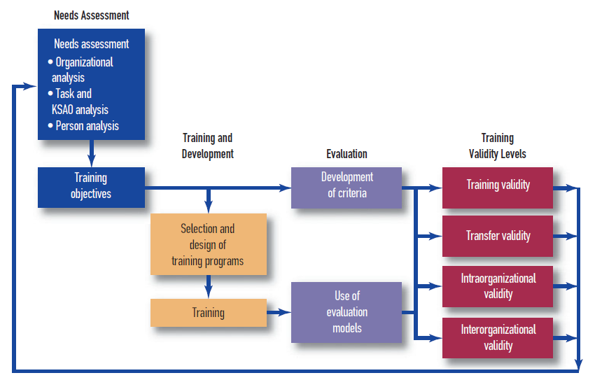


Slide 70
Training - Systematic acquisition of skills, concepts, or attitudes that result in improved performance in another environment.
Learning A relatively permanent change in behavior and human capabilities produced by experience and practice.
Learning outcomes can be organized into three broad categories: cognitive, skill-based, and affective outcomes
Cognitive outcome - Type of learning outcome that includes declarative knowledge, or knowledge of rules, facts, and principles.
Skill-based outcome - Type of learning outcome that concerns the development of motor or technical skills.
Affective outcome - Type of learning outcome that includes attitudes or beliefs that predispose a person to behave in a certain way.

Slide 71
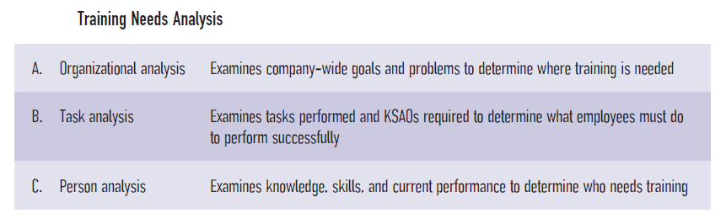
It is important to note that training, learning, and performance are distinct concepts.
Performance - Actions or behaviors relevant to the organization’s goals; measured in terms of each individual’s proficiency.
Training needs analysis - A three-step process of organizational, task, and person analysis; required to develop a systematic understanding of where training is needed, what needs to be taught or trained, and who will be trained.

Slide 72
Organizational analysis - Component of training needs analysis that examines organizational goals, available resources, and the organizational environment; helps to determine where training should be directed.
Task analysis - Component of training needs analysis that examines what employees must do to perform the job properly. Task analysis can also include an assessment of competencies, sets of behaviors that are instrumental in the delivery of desired results or outcomes.
Person analysis - Component of training needs analysis that identifies which individuals in an organization should receive training and what kind of instruction they need.
After training needs have been determined and used to develop training objectives, training design begins with an understanding of how learning occurs.
Trainee readiness refers to whether employees have the personal characteristics necessary to acquire knowledge from a training program and apply it to the job.

Slide 73
Another indicator of trainee readiness is goal orientation. Individuals with a performance orientation are concerned about doing well in training and being evaluated positively.
Performance-oriented learners are often sensitive to feedback, which can lead them to reduce their efforts and goals in challenging situations.
In contrast, individuals with a mastery orientation are concerned with increasing their competence for the task at hand, and they view errors and mistakes as part of the learning process. Mastery-oriented individuals are flexible and adaptable in learning situations, which is particularly critical for learning dynamic tasks and complex decision making.
An additional indicator of readiness is the trainee’s experience level.
Trainee motivation is the extent to which trainees are interested in attending training, learning from training, and transferring the skills and knowledge acquired in training back to the job.
Researchers often use an expectancy framework to study and understand training motivation, an approach in which employees’ expectations about the relationship between how much effort they expend and how well they perform are important to their motivation and learning.

Slide 74
Training methods
Training methods are generally categorized into on-site and off-site programs, and each of these categories can be divided into several types.
Salas and Cannon-Bowers (2001) echoed this idea by noting that most effective training methods are created around four basic principles:
1. They present relevant information and content to be learned.
2. They demonstrate KSAOs to be learned.
3. They create opportunities for trainees to practice the required skills.
4. They provide feedback to trainees during and after practice.
On-the-job training involves assigning trainees to jobs and encouraging them to observe and learn from more experienced employees.
Apprenticeship is a formal program used to teach a skilled trade.
Job rotation Approach that involves moving employees to various departments or areas of a company or to various jobs within a single department.

Slide 75
Off-site training methods
Classroom lecture Training method in which the trainer communicates through spoken words and audiovisual materials what trainees are supposed to learn; also commonly used to efficiently present a large amount of information to a large number of trainees.
Programmed instruction, an approach in which trainees are given instructional materials in written or computer-based forms that positively reinforce them as they move through the material at their own pace.It can be structured as linear programming, in which all trainees proceed through the same material, or branching programming, a customized approach that gives each learner extra practice on material he or she had difficulty with when it was first presented.
Simulator, a teaching tool designed to reproduce the critical characteristics of the real world in a training setting that produces learning and transfer to the job.
Distance learning allows trainees to interact and communicate with an instructor by using audio and video (television, computer, or radio) links that allow for learning from a distant location (Goldstein & Ford, 2002). Distance learning can occur across multiple sites at one time, and it provides a more affordable, learning-tailored alternative to live instruction (Hannafin & Hannafin, 1995).

Slide 76
A relatively new training approach involves blended learning, which refers to the use of distance learning in combination with face-to-face learning.
Like distance learning, computer-based training has expanded greatly in recent years. Many organizations are moving a growing proportion of their training from traditional classroom settings to computer-based training because of its reduced costs and increased flexibility.
Computer-based training is defined as “text, graphics, and/or animation presented via computer for the express purpose of teaching job-relevant knowledge and skills”.
Because trainees do not naturally make good use of the increased control they are given in computer- and web-based training programs, studies have examined the effects of providing trainees with adaptive guidance. Adaptive guidance provides trainees with information that helps them interpret their past performance and also determine what they should be studying and practicing to improve their future performance.

Slide 77
Training Evaluation
Training evaluation involves the systematic collection of descriptive and judgmental information that can be used to make effective training decisions. Such decisions include the selection, adoption, modification, and financial evaluation of various training activities (Goldstein & Ford, 2002). Implicit in this definition are several purposes of training evaluation (Sackett & Mullen, 1993):
To determine whether trainees have achieved the objectives of the training program.
To provide feedback that can improve training programs for future participants, ultimately increasing their job performance and productivity.
To justify the costs of training programs, which can be expensive. Evaluation can demonstrate the worth of training to top management by indicating whether the accomplishment of key business objectives improved after training.

Slide 78
Training Criteria
Kirkpatrick’s (1959, 1998) four-level model is the most common and well-known framework with which to categorize training criteria.
Reaction criteria (level 1) are measures of trainee impressions of the training program. Measures of reaction criteria are sometimes called “smile sheets” because they simply assess trainees’ enjoyment of and satisfaction with the training program (Sitzmann, Brown, & Casper, 2008).
Learning criteria (level 2) assess how much trainees learned in the training program. Learning criteria are often assessed with a written test, which might evaluate knowledge acquired in a training program.
Behavioral criteria (level 3) measure how well the behaviors learned in training transfer to the job. Behavioral criteria might include ratings of on-the-job performance of behaviors taught in the training program.
Results criteria (level 4) provide measures of how well the training can be related to organizational outcomes. For example, results criteria might assess the extent to which a training program resulted in productivity gains, cost savings, error reductions, or increased customer satisfaction.
Reaction and learning criteria are considered internal criteria because they focus on what occurred within the training program. Behavioral and results criteria are considered external criteria because they assess changes that occur back on the job.

Slide 79
Training Evaluation Designs
The purpose of training is to bring about systematic changes in knowledge, skills, and attitudes. Evaluation designs are used to determine whether training objectives have been met and whether post-training improvements in knowledge, skills, and attitudes are a result of training. Training evaluators attempt to infer whether such improvements are a result of the training program.
The strongest training evaluation designs include random assignment of participants to conditions, a control group, and measures that are obtained both before and after training has occurred. An example of a design that includes these characteristics is the pretest–posttest control group design, a design that generally includes random assignment of participants to conditions, a control group, and measures obtained both before and after training has occurred.

